Slide 1

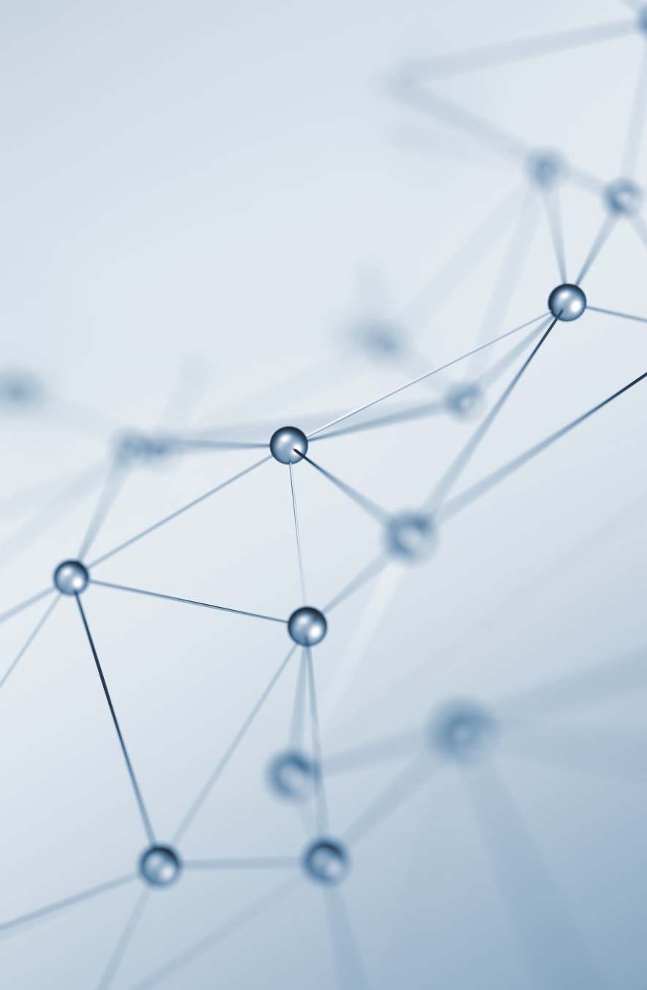

B.A.T.M.A.N Protocol better approach to mobile ad hoc networking
Concurrent and Distributed Programming
Dr. Yehuda Ben-Shimol
Mr David Leon
Authors – Amit Nagar-Halevy and tal kapelnik

Slide 2
What Is BATMAN Protocol?
B.A.T.M.A.N. is a proactive routing protocol for Wireless Ad-hoc Mesh Networks. The protocol proactively maintains information about the existence of all nodes in the mesh that are accessible.
The strategy of B.A.T.M.A.N. is to determine for each destination in the mesh one single-hop neighbor, which can be utilized as best gateway to communicate with the destination node. To learn about the best next-hop for each destination is all that the B.A.T.M.A.N. algorithm cares about.
There is no need to find out or calculate the complete route, which makes a very fast and efficient implementation possible.

Slide 3
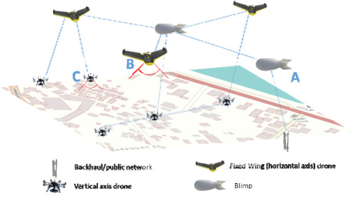
Real life uses
Military arena: An ad hoc networking will allow the military battleground to maintain an information network among the soldiers, drones, vehicles and headquarters.
Provincial level: Ad hoc networks can build instant link between multimedia network using computers to spread and share information among participants.
Emergency situation: such as disaster relief. The rapid development of non-existing infrastructure makes the ad hoc network easily to be used in emergency situation.

Slide 4
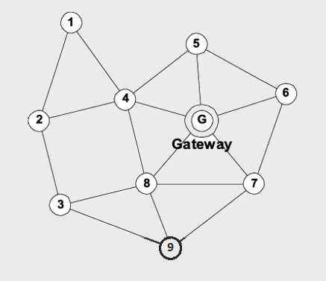
PROTOCOL
Every Originator Interval, Every BATMAN Interface will send an Originator Message (OGM) to all of his neighbors ( the other Robins in the given Radius).
The OGM contains:
Sequence Number- a number that increases every OGM, it makes the OGM unique.
TTL- Time To Live, how many Robins can pass the OGM until it dies.
Robin Address- who the original sender of the OGM.
Receiving OGM:
Each OGM it receives from other Robin, it will decide if it needs processing and/or rebroadcast it to my neighbors.
Rebroadcasting an OGM- sending the OGM to the neighbors with TTL changed to TTL-1. If the TTL now is 0 it will not rebroadcast.
if the OGM needs processing we will update this map, Known Map, that each Robin has

Slide 5
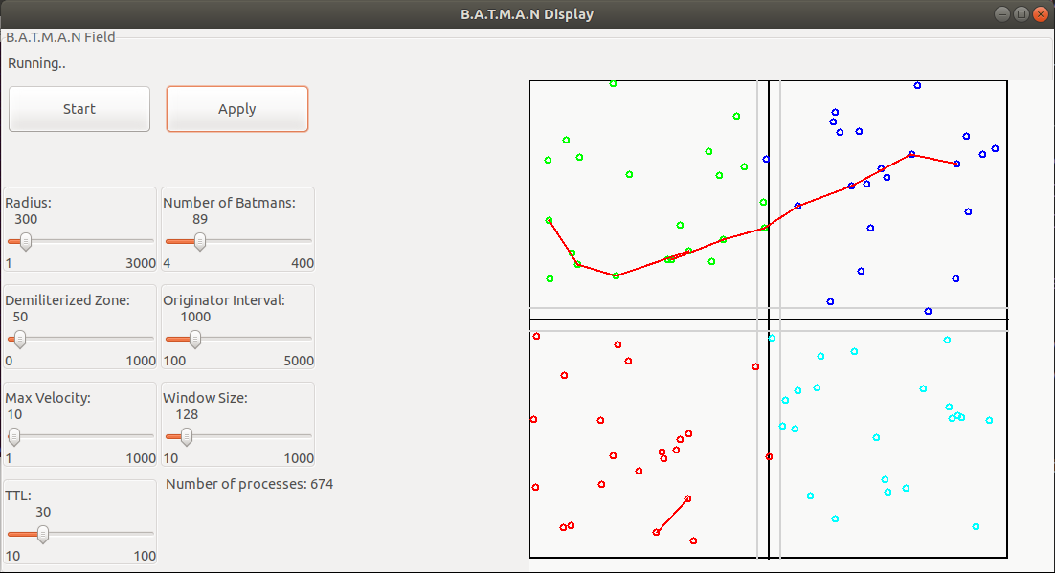
IMPLEMENTATION
BATMAN protocol was created to route messages in the real-world
The Following Image will demonstrate a field of 2 KM x 2KM square.
Each quarter is a computer server that runs a simulation of real-life motion

Slide 6

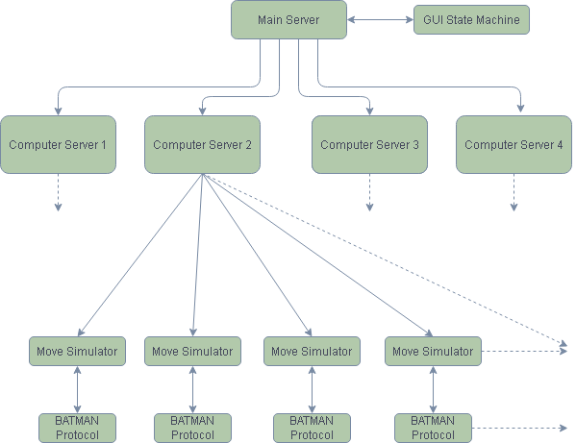



Dependencies Flow

Slide 7
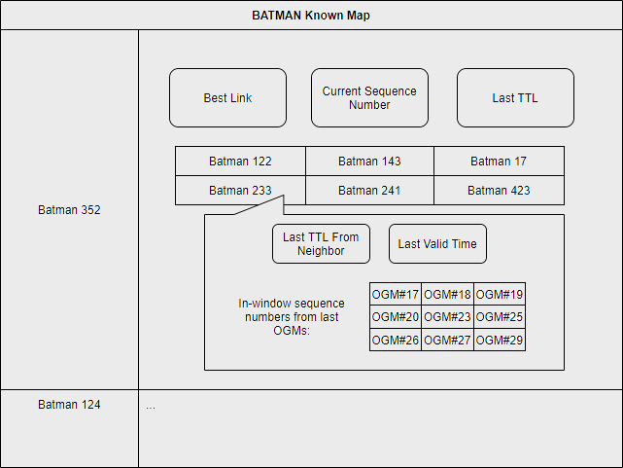
BATMAN DATABASE
Each BATMAN maintains a map for all other known BATMANs in the mesh grid.
For each entery save-
The best link for messaging
Current Sequnce Number of OGM
Last TTL
List of neighbors that passed an OGM from this BATMAN
For each entery in this list Save-
Last TTL
Last valid time
In – window received messages

Slide 8
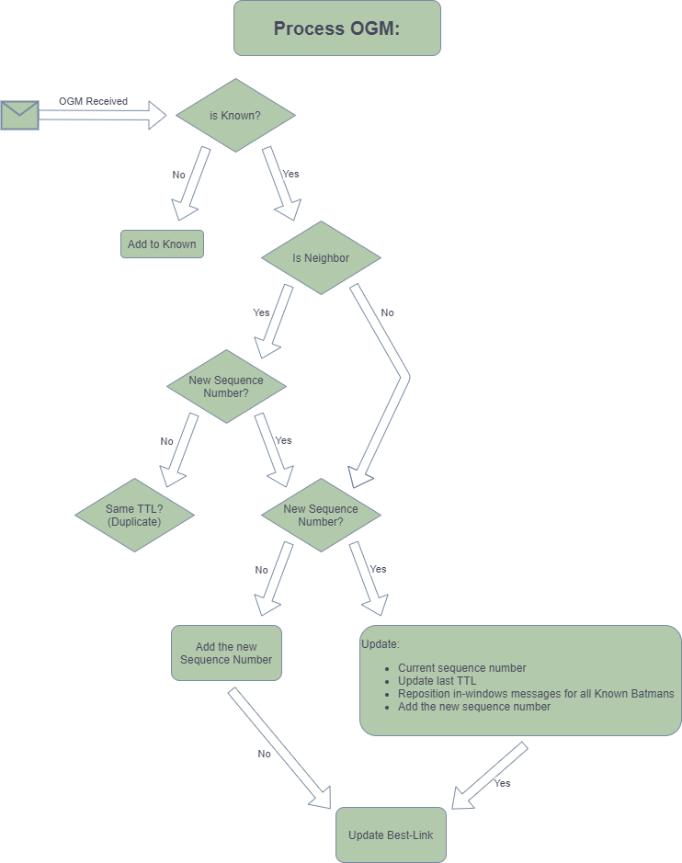
Processing an OGM
For every OGM received follow the next steps to process the message

Slide 9
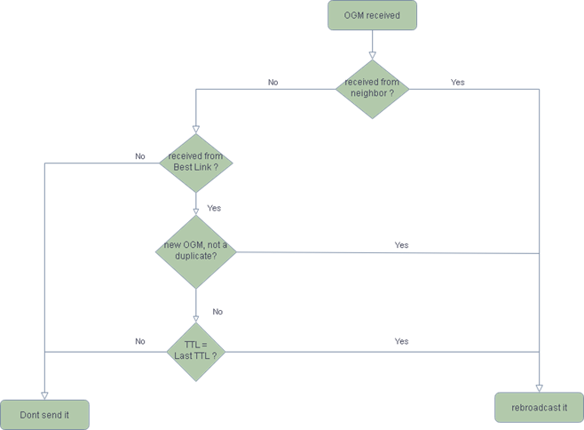
Rebroadcasting an OGM
Flooding the mesh grid with OGM messages must be done carefully, in-order to maintain a fast and efficient messaging system

Slide 10
Main Server
The Main Server, on start initiating all the Computer Servers in the right boarders.
Generating a GUI state machine for printing to the screen.
He has an EtsRobins- where all the Robins and their locations are located, he updates it regularly.
In charge on monitoring the crashes of Computer Servers and telling other Computer Servers to take the falling node area.

Slide 11
Computer Server
The Computer Server is the main server of each node (except of the Main Server node himself).
It spawns and monitors all the Robins in his area.
It is responsible for communication with the other Computer Servers.
It will update the Main Server on the Location of his Robins, and the Messages that was send.
It maintains 2 Ets’s:
EtsX and EtsY- each contains all the Robins Addresses at a particular X or Y.
It supports changing his boarders when other node crashes.

Slide 12
Move Simulator Server
This server responsible on the movement and communication with other Robins.
Movement:
Every random time (within a range) it will generate new Direction and Velocity.
it will update the EtsX and EtsY
Communication:
When an OGM need to be sent to the neighbors it will calculate the neighbors in my radius.
For the Robins on my Computer it will send them the OGM directly,
if my location indicates that I may have neighbors on other computers (close to the boarder), then it will send to my Computer Server the OGM to handle it.

Slide 13
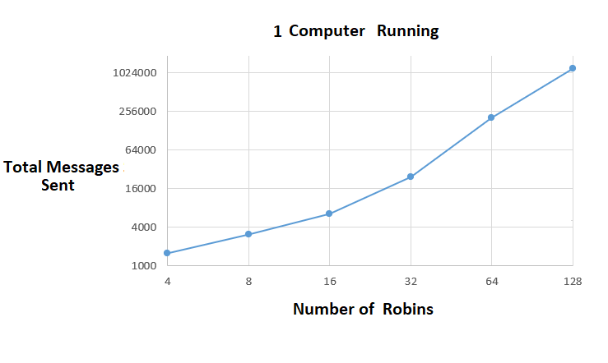
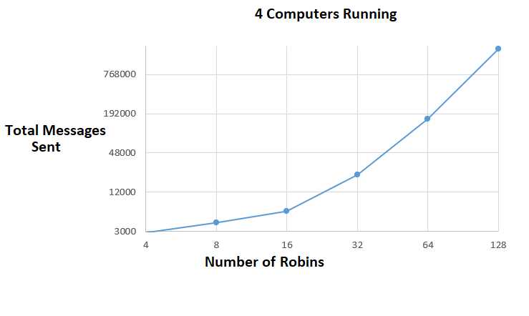
Statistics
Here we can see the difference in the amount of total messages sent between all servers.
We can see that when 4 computers are running, a lot more messages are being sent, and the main reason will be communications and transitions between computers

Slide 14
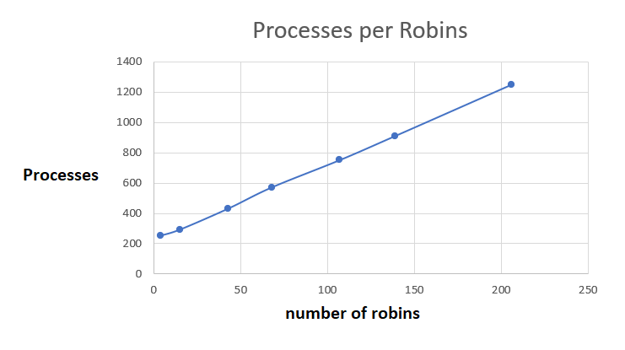
Statistics

Slide 15
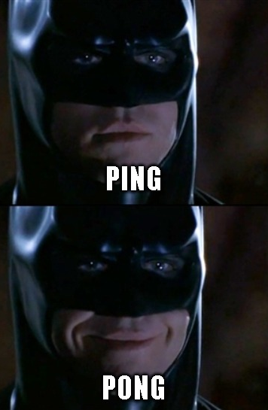
Thank You! YouTube Video – https://youtu.be/pucyr1thcpM GitHub Link – https://github.com/amitnh/Erlang-Final-Batman

